Slide 1
ELEMENTS OF COMPUTING
END SEMESTER PROJECT

Slide 2
TEAM MEMBERS
01
02
03
04
G.SRI VATSANKA
G.HIMAMSH
CB.EN.U4AIE.21010
CB.EN.U4AIE.21014
M.PRASANNA TEJA
VIKHYAT BANSAL
CB.EN.U4AIE.21035
CB.EN.U4AIE.21076

Slide 3
PART-1

Slide 4
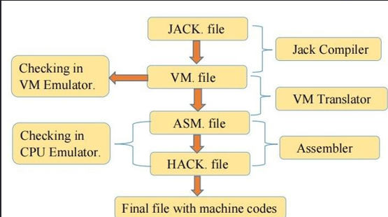
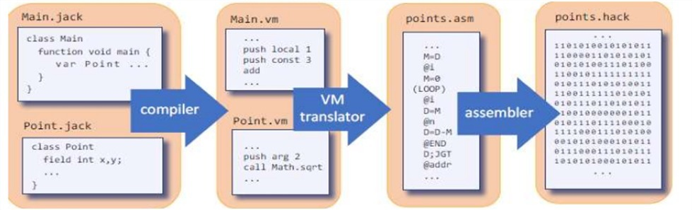
Conversion of files

Slide 5
Required Steps:
Step-1
We will convert .Jack files to .VM files.
Step-2
Conversion of .VM files to .ASM files.
Step-3
.ASM files to hack files conversion.

Slide 6
INTRODUCTION
We must develop a Jack code and use the Jack Compiler to compile the Jack file to VM file. Later, the VM file will be translated to an assembly language code file, which is abbreviated as ASM.
After developing the ASM file, that ASM file will be converted to a HACK file with help of ASSEMBLER.
The appropriate files, such as VM, ASM, and hack files, must be examined in the appropriate platforms, such as VM emulator, CPU emulator, hardware simulator. The NAND2TETRIS folder is the source of this program.

Slide 7
JACK LANGUAGE
Jack is simple Object-based language that can be used to write High-Level programs .It has been a basic features and flavor of modern object-oriented language like java with much simpler syntax and no support for inheritance.
We use jack language as a means for teaching of,
Keyboard class allows the reading from a standard keyboard.
How to create a compiler.
To see how compiler and language interfere with the program.

Slide 8
JACK Standard library
The jack programming language includes a standard library which can be seen as an interface to an underlying operating system. The Library is a set of jack classes that must be included in every jack implementation.
The following classes are included in a standard Library :
Math: Provides basic Mathematical operations.
String: Implements the string type & basic string-related operation
Array: Defines array type, array construction & disposal of array
Output: Handles text-based output.
Screen: Handles Graphic screen output.
Keyboard: Handles user input from the keyboard
Memory: Handles memory operations.
Sys: Provides some execution-related services.

Slide 9
THE PROJECT
Implementing Keyboard Library in Jack
Returns the ASCII code (as char) of the currently pressed key, or 0 if no key is currently pressed.
Reads the next character from the keyboard: wait until a key is pressed and then released, then echos the key to the screen and returns the value of the pressed key.
Prints the message on the screen, reads the next line from the keyboard ,echoes the line to the screen, and returns it's value. This method handles user backspaces.
Prints the message on the screen, reads the next line from the keyboard ,echoes the line to the screen, and returns the integer until the first non-numeric character in the line. This method handles user backspaces.

Slide 10
Keyboard Class
This class allows reading the input from the keyboard.
Function char keyPressed(): Returns the character of the currently pressed key on the keyboard ;if no key is currently pressed, returns 0.
Function char readChar(): waits until a key is pressed on the keyboard and released and echoes the key to the screen and returns the character of the pressed key.
Function string readLine(string message):Prints the message on the screen, reads the next line from the keyboard ,echoes the line to the screen, and returns it's value. This method handles user backspaces.
Function int readInt(string message):Prints the message on the screen, reads the next line from the keyboard ,echoes the line to the screen, and returns the integer until the first non-numeric character in the line. This method handles user backspaces.

Slide 11
ASCII CODE
ASCII stands for "American standard code for information interchange".
ASCII is 7-bit character set containing 128 character.
It contains numbers from 0-9 ,the upper and lower cases English letter from A to Z and some special character(!,@,#,%,*...etc).
The characters are used in modern computers ,Html and on internet are based on ASCII code.

Slide 12
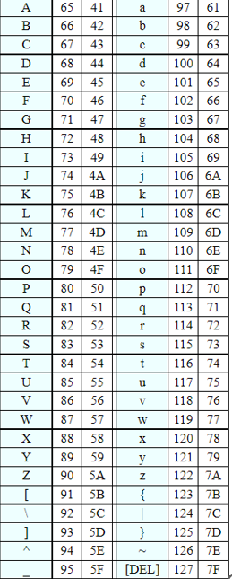
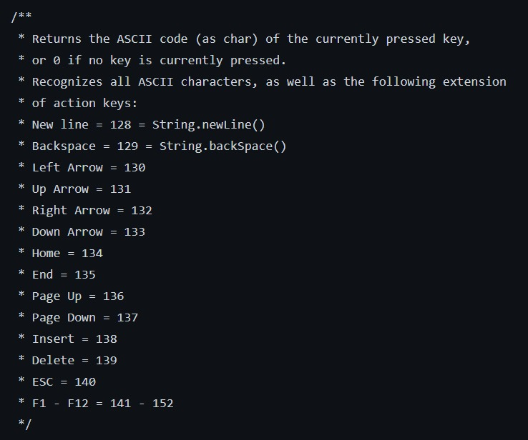
ASCII TABLE

Slide 13
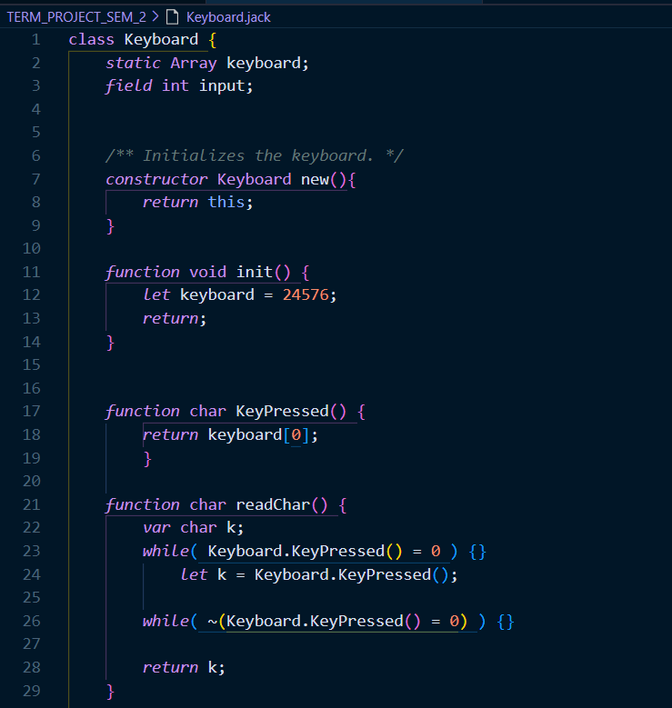
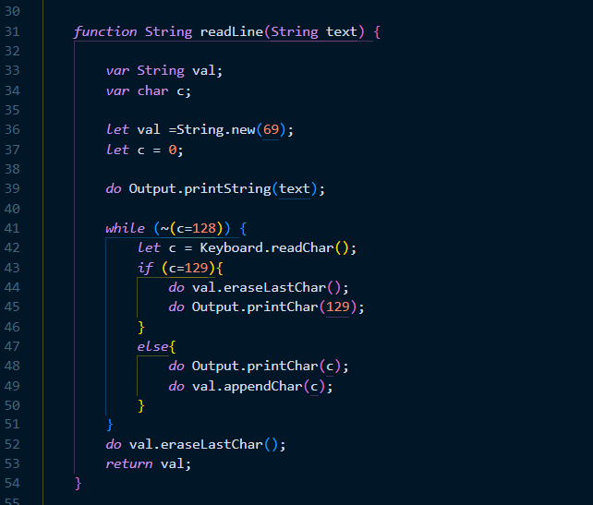
Keyboard jack code

Slide 14
Keyboard jack code

Slide 15
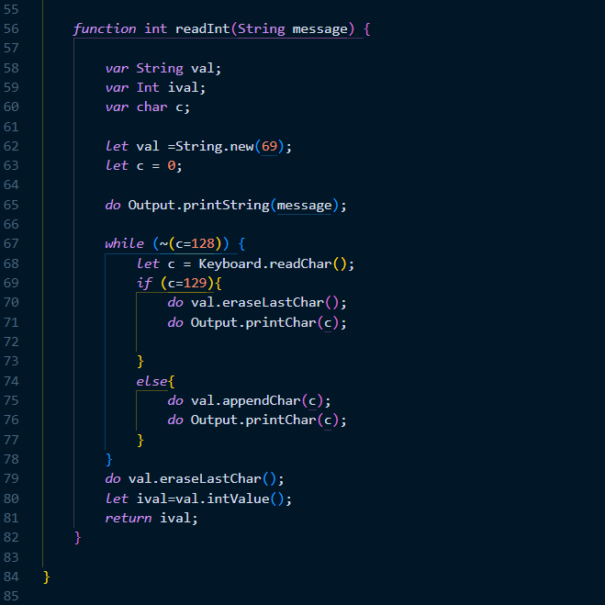
Keyboard jack code

Slide 16
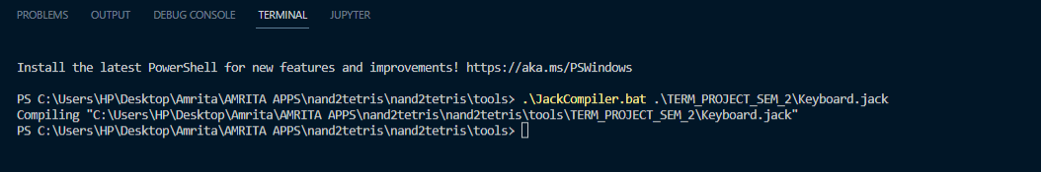
Compiled Keyboard code

Slide 17
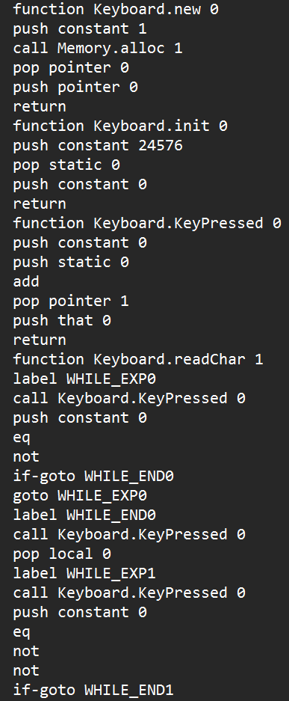
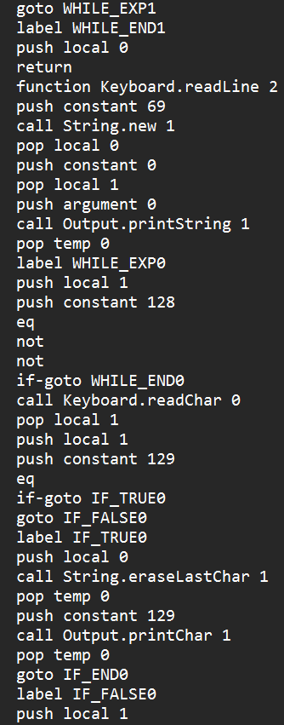
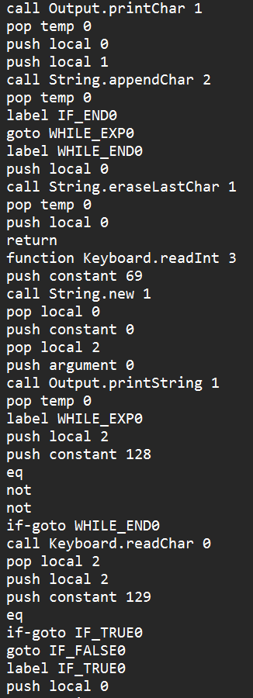
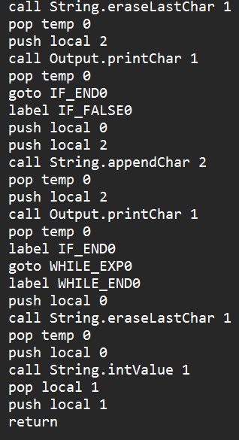
Keyboard.vm code

Slide 18
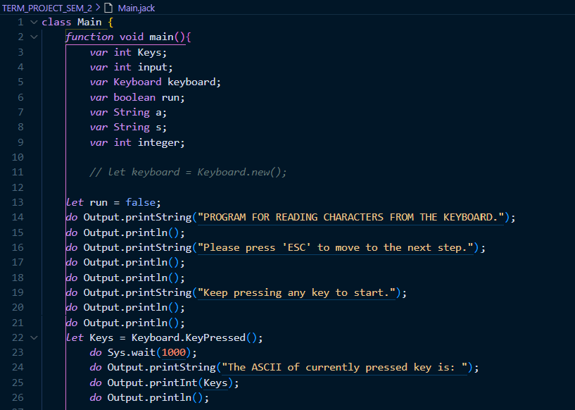
Main jack code

Slide 19
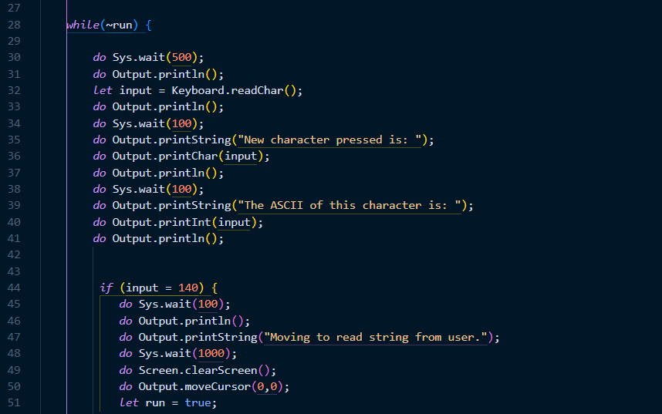

Slide 20
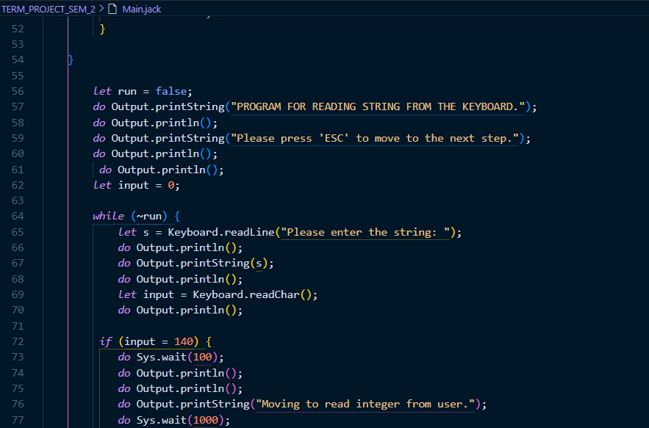

Slide 21
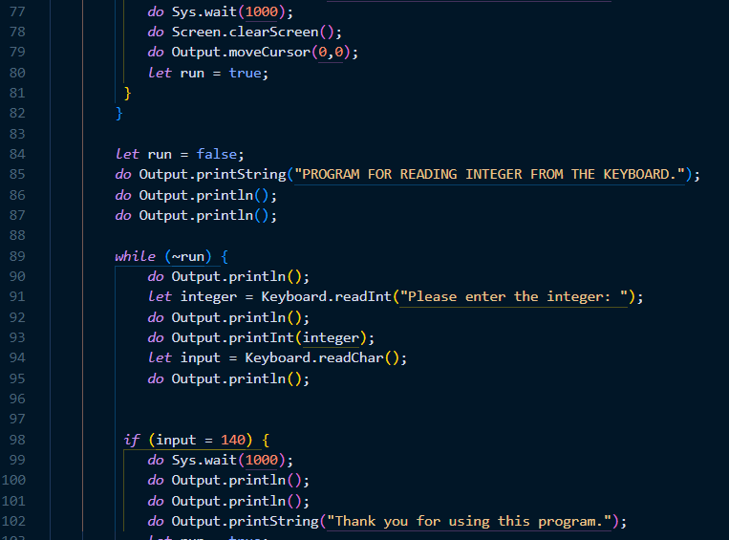

Slide 22
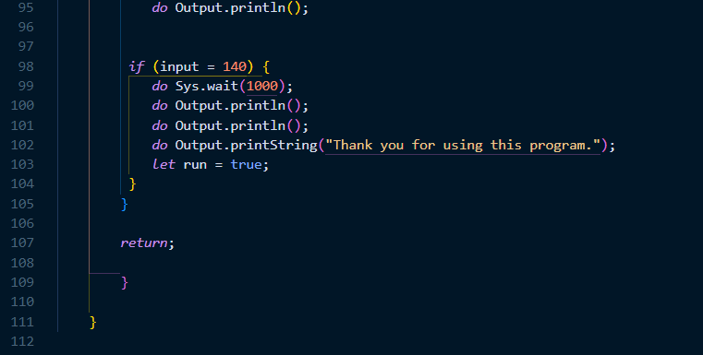
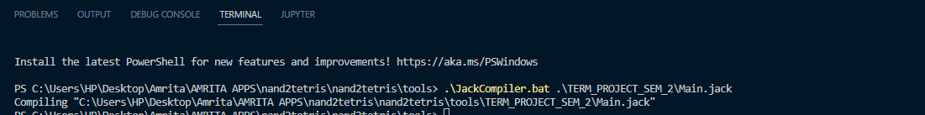
Compiled MAIN code

Slide 23
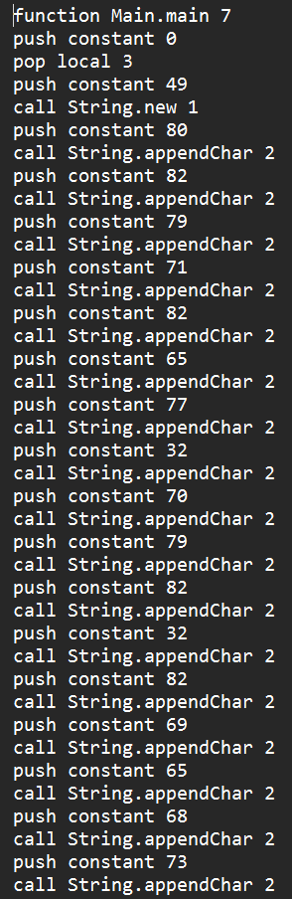
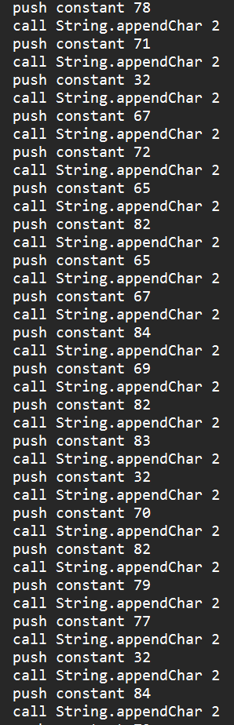
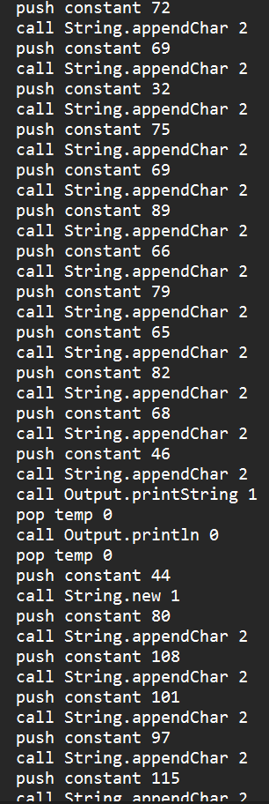
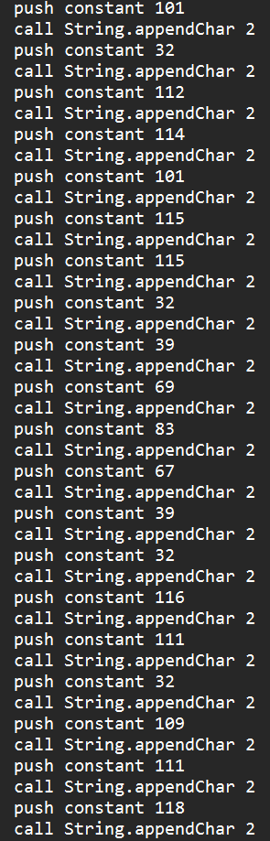
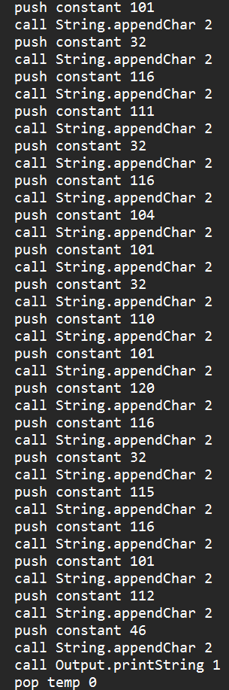
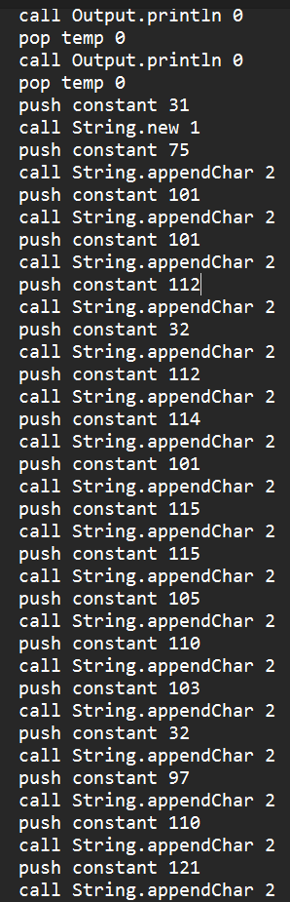
Main.vm code

Slide 24
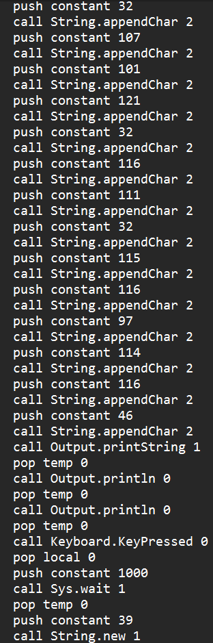
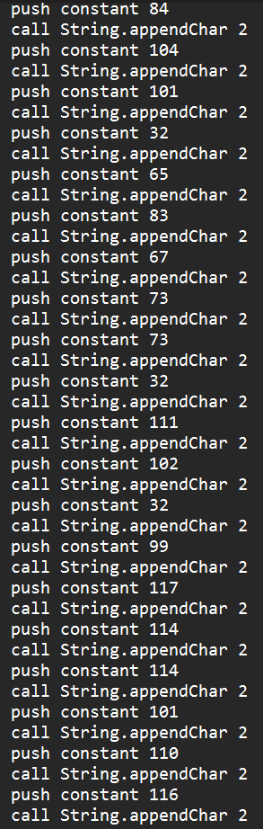
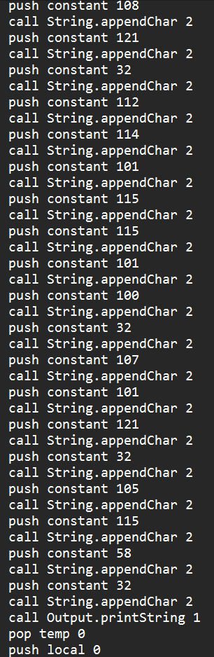
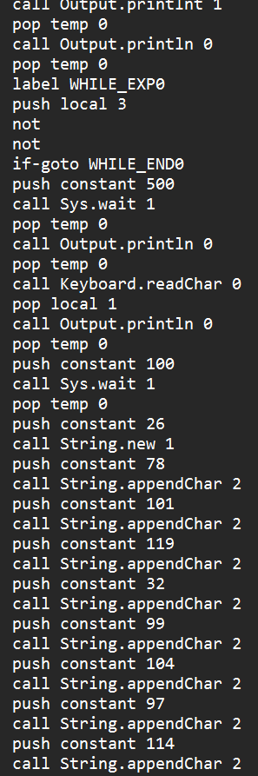
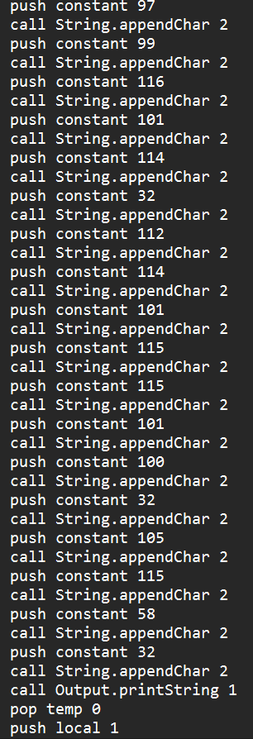
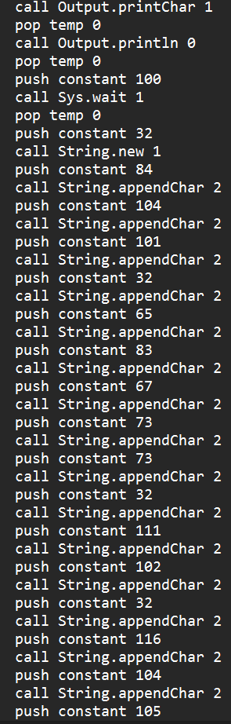

Slide 25
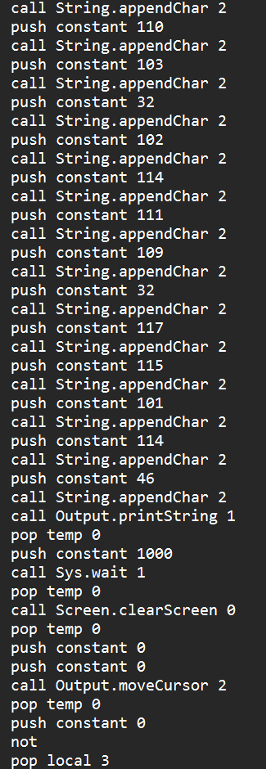
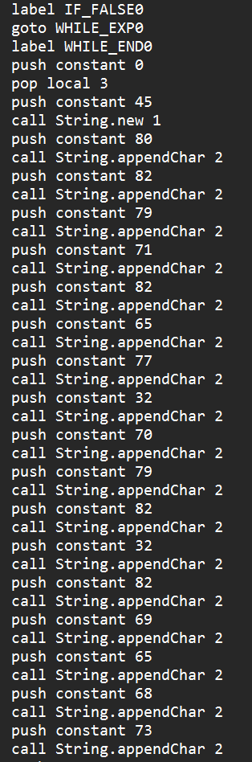
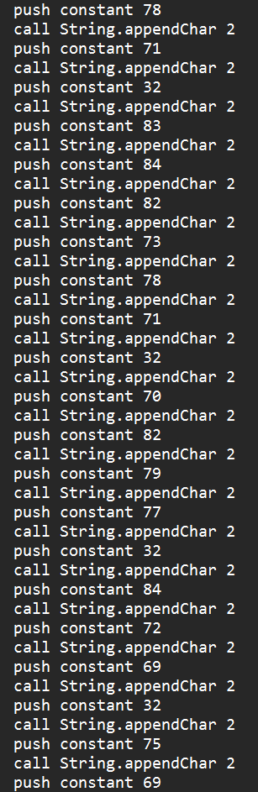
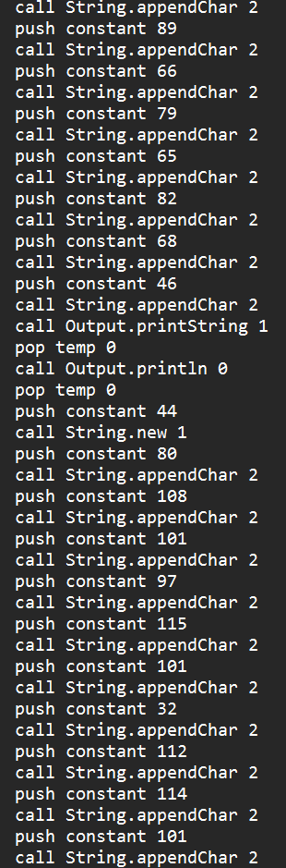
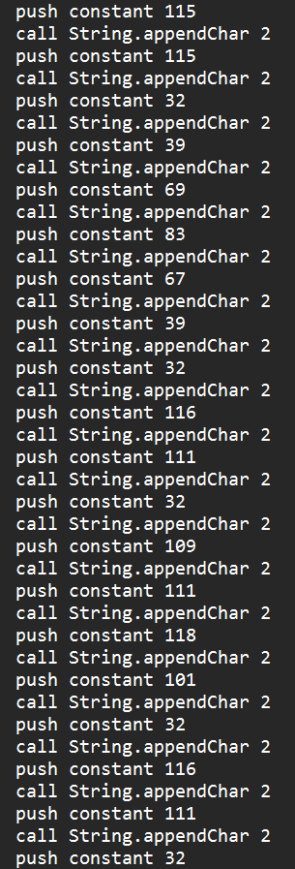
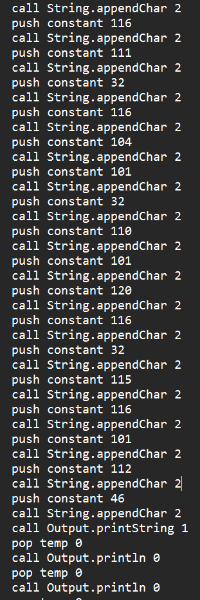

Slide 26
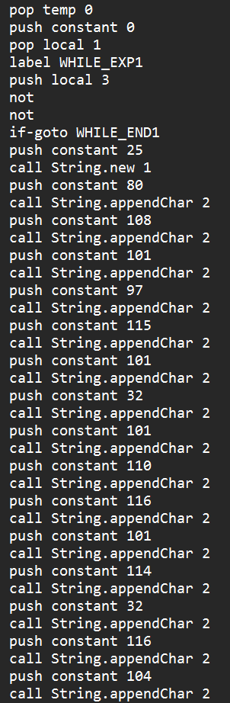
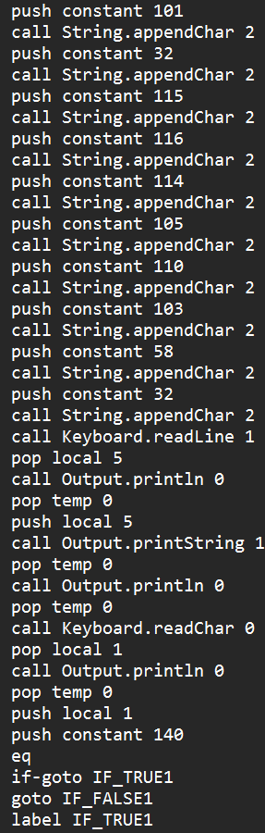
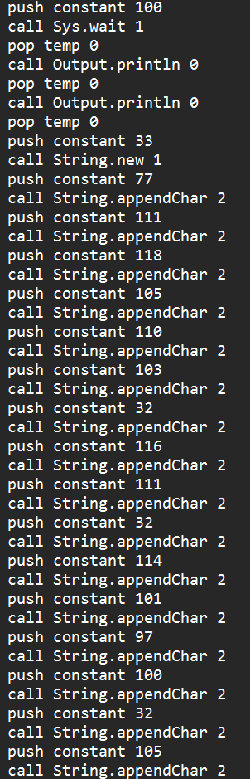
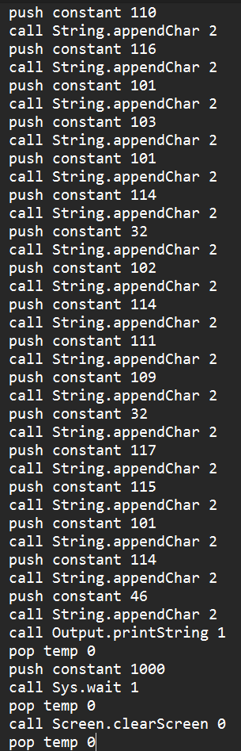
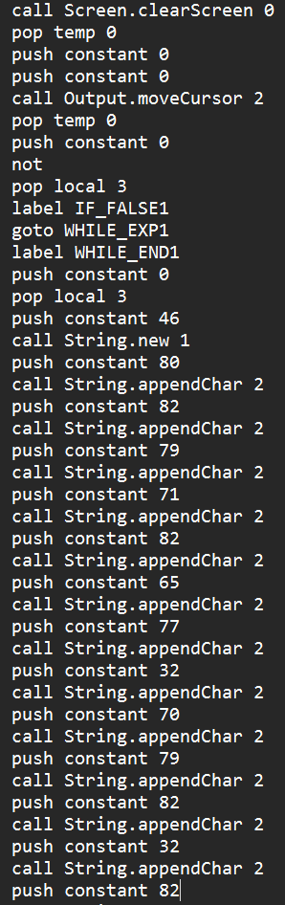
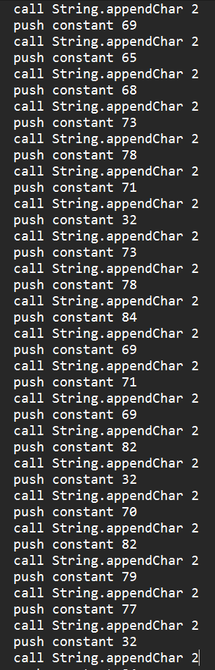

Slide 27
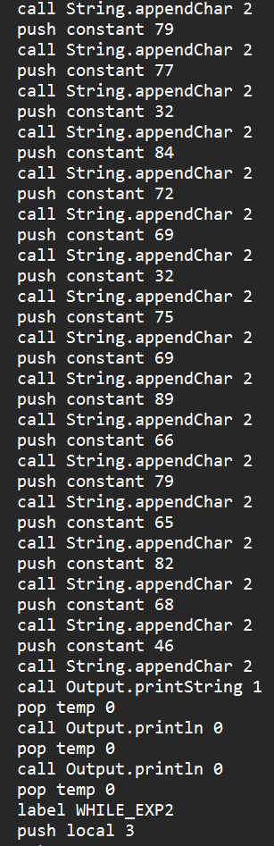
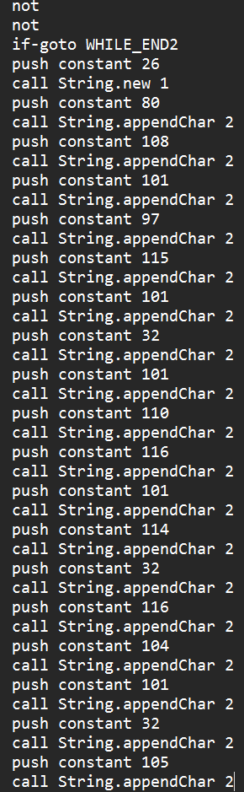
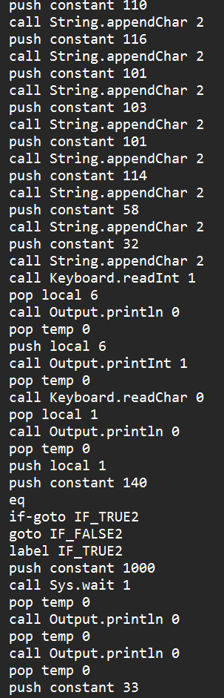
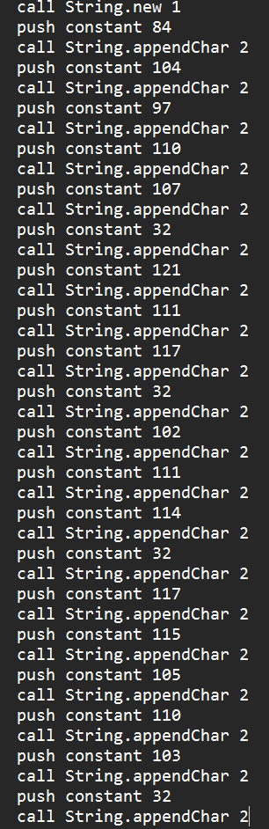
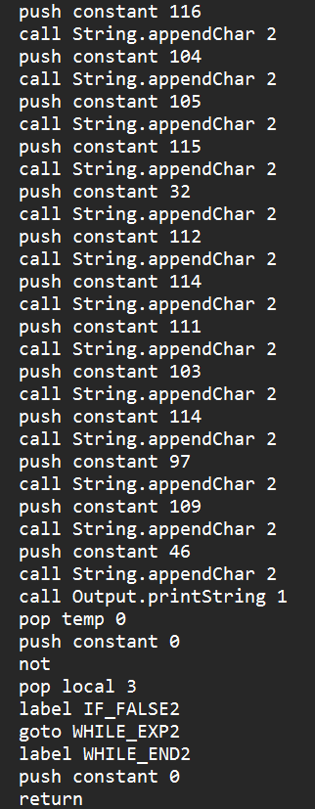

Slide 28
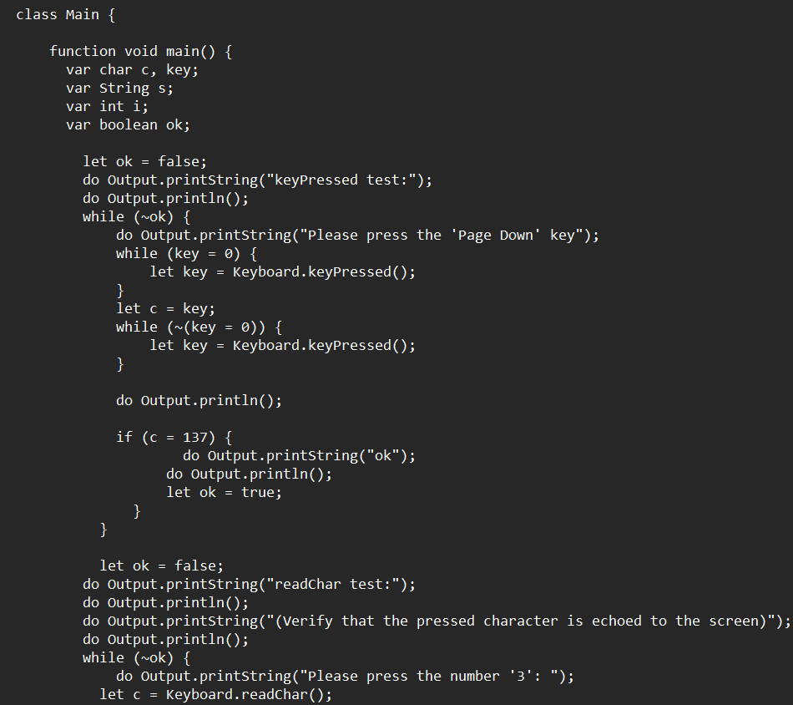
Main Test File
We have a test code in nand2tertris to crosscheck the keyboard library we created.
Location nand2tetris→projects→12→keyboardtest.

Slide 29
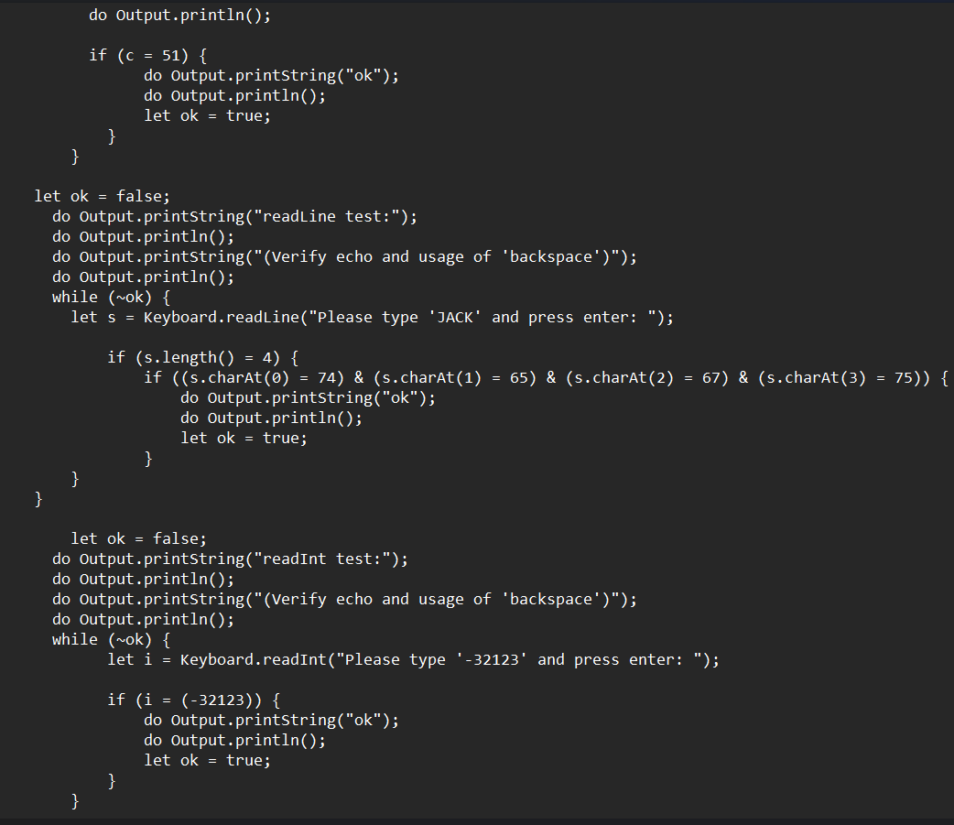
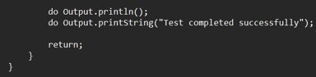

Slide 30

Keep all VM files in same folder.
To work with your own keyboard library, one can select and load the complete folder on VM Emulator.

Slide 31
VM Implementation
Returns the ASCII code (as char) of the currently pressed key, or 0 if no key is currently pressed.
Reads their next character from the keyboard: wait until a key is pressed and then released, then echoes the key to the screen and returns the value of the pressed key.

Slide 32


Slide 33


Slide 34
VM IMPLEMENTATION
Prints the message on the screen, reads the next line from the keyboard ,echoes the line to the screen, and returns it's value. This method handles user backspaces.

Slide 35


Slide 36
VM IMPLEMENTATION
Prints the message on the screen, reads the next line from the keyboard ,echoes the line to the screen, and returns the integer until the first non-numeric character in the line. This method handles user backspaces.

Slide 37


Slide 38
PART-2

Slide 39
Topic
Write your own general purpose assembler to convert the assembly program into 16 bit machine codes also use the Nand2tetris assembler for conversion. (Your own assembler should be developed by you and is different from the assembler tool supplied along with the book)

Slide 40

Assembler code

Slide 41


Slide 42


Slide 43


Slide 44

Creating .hack for our keyboard library and Main file

Slide 45

Comparing our KEYBOARD assembler file with the IN-BUILT assembler

Slide 46

Comparing our MAIN assembler file with the IN-BUILT assembler

Slide 47
Backup FILE!!

Slide 48

Note: Firstly, one must convert .VM file to .asm file using a VM translator and then start working with assembler. We have to keep all the files in the same folder.

Slide 49

Now in the terminal we use the command "python .\Assembler.py .\Max.asm" to convert asm.file to hack.file .

Slide 50

Converting .asm file to .hack file using nand2tetris software, by using assembler tool.

Slide 51


Both the hack files that we obtained using our own assembler and nand2teris are similar.

Slide 52
PART-3

Slide 53
Topic
Dump the machine codes generated by your own assembler into the Computer.hdl. Then design the architecture for implementing your machine instructions to get the result. (Here I presume that you already have the hdl scripts of all the hardware’s used by the CPU. Additional thing what you have to do is connecting the address and data buses during the execution).

Slide 54
CENTRAL PROCESSING UNIT
The control unit is in charge of all CPU functions, including ALU operations, data transfer inside the CPU, and the interchange of data and control signals across external interfaces.
The control unit is in charge of all CPU functions, including ALU operations, data transfer inside the CPU, and the interchange of data and control signals across external interfaces.

Slide 55


CPU Design
Instruction Memory -It contains a 16 bit ‘instruction’ as input and the output of PC can be explained based on Instruction memory.

Slide 56
What does it mean by 16-bit Instructions?
There are two sorts of 16-bit instructions: A instructions and C instructions. Now, from the 0th to the 15th bit, if the first bit (i.e., the T-pin) is zero, it is an A instruction; if the first three bits are 1 1 1, or if the addition of the first bit is certain, it is a C instruction.
If the first bit is zero, the instruction is an A; if the first bit is one, the instruction is a C-instruction.
For the A instruction, the remaining 15 bits are value, which is saved in the A register and then outputs the value.
However, if I have a C instruction, then everything is entirely different. In this case, the 13 instruction bits are decoded into the Op-code (treat it as letter "a"), ALU control bits, Destination load bits, and Jump bits.

Slide 57

Computer.hdl file

Slide 58

Working with .hack file of KEYBOARD & MAIN

Slide 59

Working with .hack file of KEYBOARD & MAIN

Slide 60

Working with .hack file of KEYBOARD & MAIN

Slide 61

ALTERNATE CODE[MAX ASM]

Slide 62

ALTERNATE CODE[MAX HACK]

Slide 63
CONCLUSION
In this project we have implemented and shown
How a Keyboard works
How a Hack Computer works
How high level language is abstracted at machine level.

Slide 64
THANK YOU

